Slide 1
Introduction to P-Value

Slide 2
Can chocolate save lives?
“ A sub-study of a population from the Zutphen Elderly Study showed that cocoa consumption was associated with a decrease in blood pressure and overall cardiovascular mortality.” – National Library of Medicine
“A case-control study done in Italy showed that the risk for myocardial infarction was inversely associated to chocolate consumption, reaching a 77% decrease in risk when comparing the population that ate more than three portions of chocolate per day with the population that consumed less than one⁹.” – National Library of Medicine
“A recent study, conducted by research teams at Harvard and in Denmark, indicates that chocolate also protects against another heart condition, atrial fibrillation (AF). AF … raises a person's risk of heart failure, stroke, dementia, and death.” – Harvard Health Publishing

Slide 3
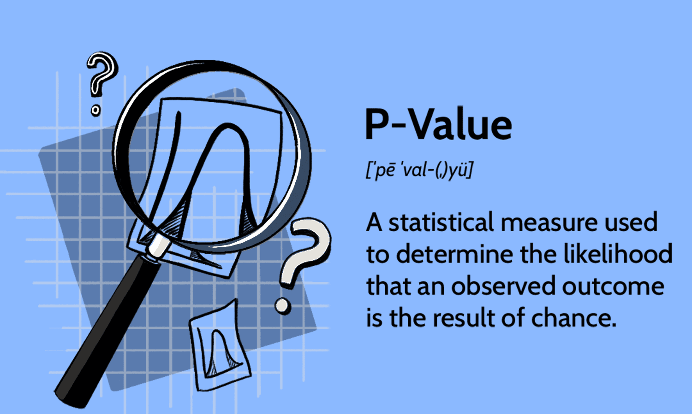
P-Value Can Test Your Suspicions
If we really wanted to see if these findings are simply due to chance or if there is an actual correlation between heart health and chocolate consumption, conducting a hypothesis test and finding the p-value would be helpful in testing your suspicions.
Image Credit

Slide 4
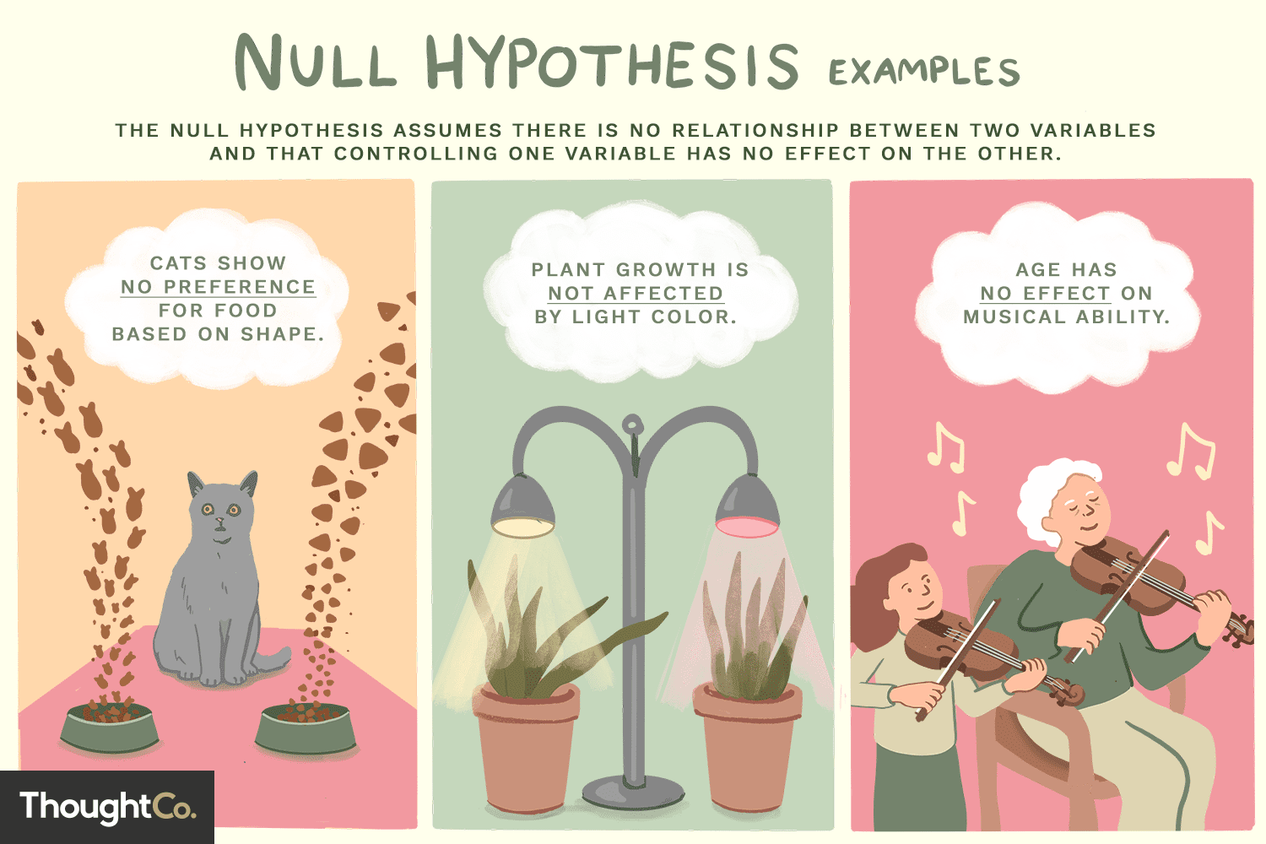
Null Hypothesis vs Alternative Hypothesis
Alternative hypothesis: Think of this as your claim and the traditional hypothesis you have been writing in your classes. Your alternative hypothesis is what you would expect to see if the effect you are studying does exist between your two groups or variables.
Null hypothesis: Your null hypothesis is what you would expect to see if the effect you are studying between your two groups or variables does not exist.
Question: What are three possible alternative hypotheses for the three null hypotheses depicted in the image?
Image Credit
Notes:
Cats prefer fish shaped food to triangle shaped food.
Plants grow faster under red light than yellow light.

Slide 5


Null or Alternative Hypothesis?
Fish in the wild have a longer lifespan than fish in captivity.
Fish in the wild do not have a longer lifespan than fish in captivity.
Question: Which is the null hypothesis and which is the alternative hypothesis?
?
Image Credit
Image Credit

Slide 6

Null and Alternative Hypothesis
Take a few moments to find your hypothesis (alternative hypothesis) that you wrote down for your ecaofabs.
Within your table groups discuss what a possible null hypothesis would be for each hypothesis you and your table members wrote down.

Slide 7


Why p-values are Important
Allow us to draw conclusions based on our data
P-values are used across MANY fields because they let you determine the statistical significance of your data/results
Confidence vs. Chance
Image credit
Image credit

Slide 8
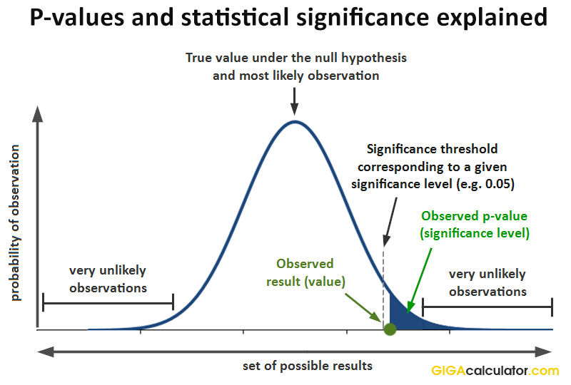
What is p-value?
Probability of seeing the observed data assuming the null is true
A common threshold is 0.05, but this can change depending on the field you are in.
Can reject the null if you get a p-value of 0.05 (conventionally) or less
Question: Can you think of a field in which you would want an even lower p-value?
Image credit
Notes:
A field where you would want an even lower p-value would be something along the lines of medicine.

Slide 9
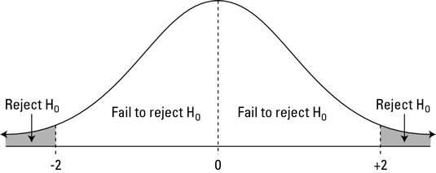
P-Value Example
Alternative Hypothesis: A bag of potato chips does not have the supposed average of 28 grams of chips per bag.
Null Hypothesis: A bag of potato chips has the supposed average of 28 grams of chips per bag.
P-value: When I simulate under the null, I get a p-value of 0.04.
Conclusion: Since my p-value is below 0.05, I can confidently reject the null hypothesis and have confidence in my alternative hypothesis that a bag of potato chips does not have an average of 28 grams of chips/bag.
My statistical significance threshold is 0.05
p-value=0.04
Image credit
Image credit

Slide 10
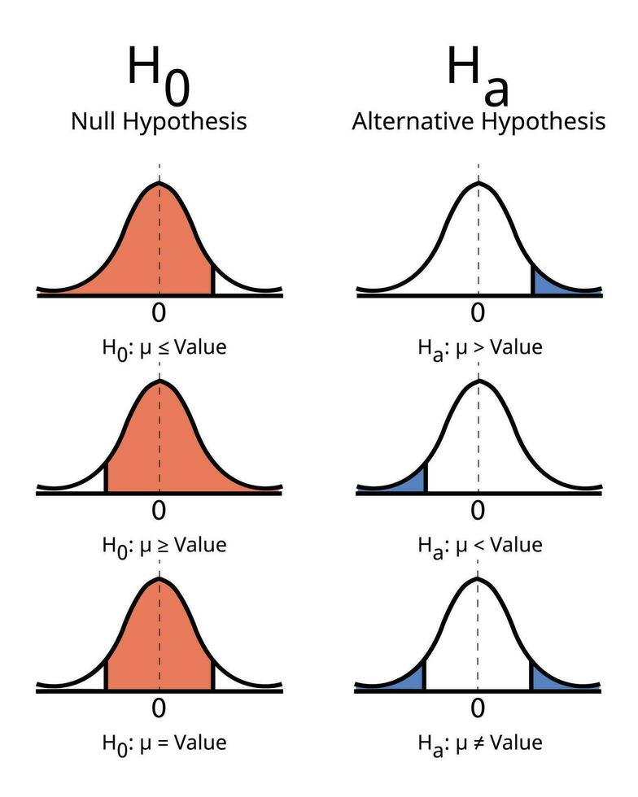
Normal Distribution and the Null Hypothesis
As mentioned, in hypothesis testing you simulate under the null hypothesis essentially meaning you assume the null is true
But why are we looking at these normal distributions or bell curves?
No matter what our sample distribution is, the distribution of the sample MEAN will always approach normal and yield a normal distribution by the Central Limit Theorem
The more samples you have, the smaller the variance, or the spread of your distribution, will be. Meaning the distribution of the sample mean becomes more narrow as it approaches the true population mean.
Image Credit

Slide 11

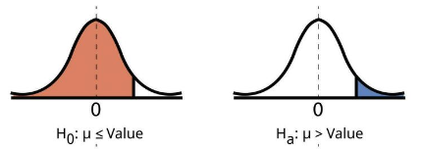
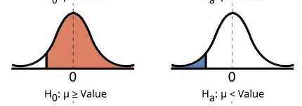
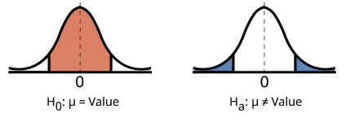
Hypotheses and the Tails of Normal Distributions
Null Hypothesis: Plants do not grow faster under red light.
Alternative Hypothesis: Plants grow faster under red light.
Null Hypothesis: Plants do not grow slower under red light.
Alternative Hypothesis: Plants grow slower under red light.
Null Hypothesis: Plants do not grow differently under red light.
Alternative Hypothesis: Plants grow differently under red light.
Image Credit

Slide 12
A Quick Note Before You Start

Slide 13
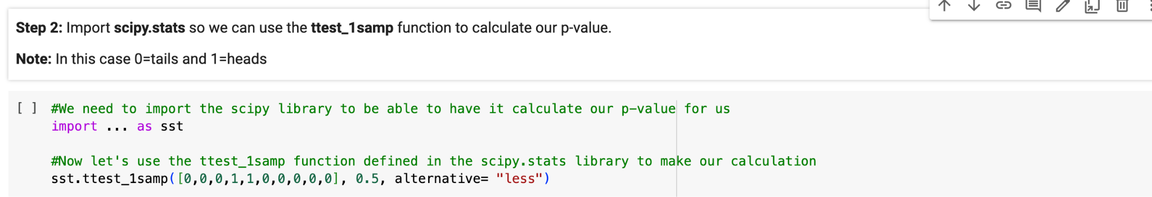
Let’s Walk Through The Function You Will Use
Your observed samples
Null population mean you are comparing your sample mean to
Defining your alternative hypothesis relative to the null population mean

Slide 14

Let’s walk through Question 1 together.
First, you’ll have 2 minutes to complete Step 1 of Question 1.
We’ll reconvene and discuss after the 2 minutes are up.

Slide 15

Now you’ll have about 1 minute to complete Step 2 of Question 1.
We’ll reconvene and discuss after the minute is up.

Slide 16
Now you’ll have 2 minutes to complete Step 3 of Question 1.
We’ll reconvene and discuss after the 2 minutes are up.

Slide 17

Now you’ll have 3 minutes to write down any final thoughts that you didn’t get to write down for Steps 4 and 5.

Slide 18

Time for a Friendly Competition
Can we say with confidence if the instructors or you, the students, are faster typers?
Let’s find out!
But first, fill out Question 2, Step 1 of your notebook (Null and Alternative Hypothesis)

Slide 19
Competition Time!
Go to typing.com/student/tests
Click on the 1:00 test
Once completed, go to the Student Typing Speeds Google Sheet and type in your words/minute in the appropriate column and indicate with an “X” whether you are left or right handed and your grade level

Slide 20
Continue the competition by starting with Question 2, Step 3 (carefully read this step in its entirety)
Then continue on with the rest of the notebook.
Raise your hand if you have questions and collaborate with your table group!

